Slide 1
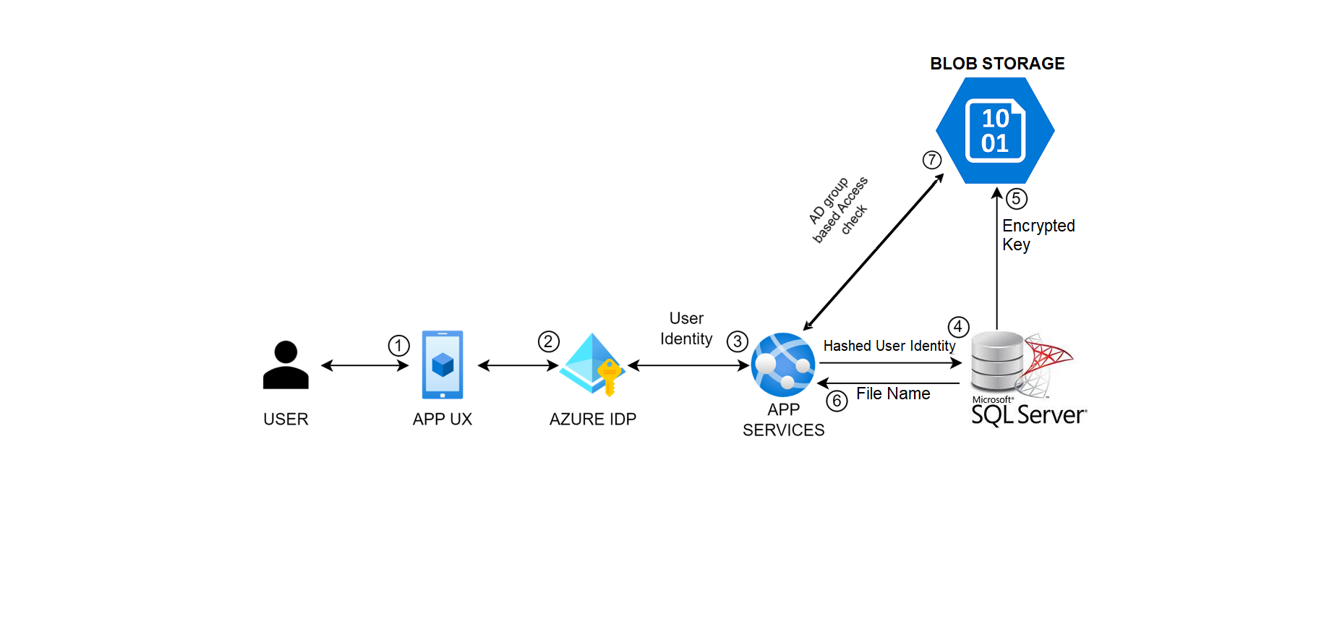
Chat History - flow
Capture Chat history by anonymizing User info

Slide 2
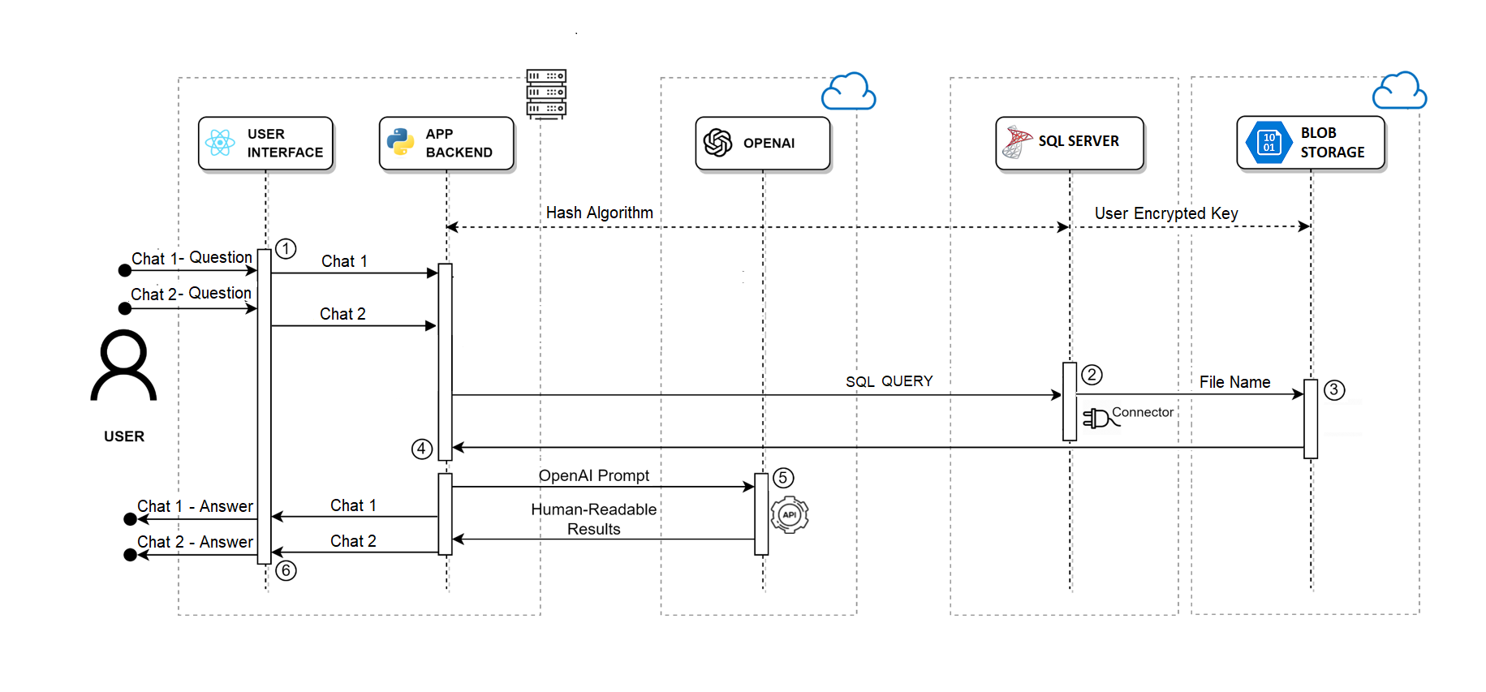
Technical Architecture – Chat History
Proposed

